Slide 1

Topic : Test Case Design Techniques
SQA & PM BootCamp
Muhammad Fahad Bashir
Week 2 Day 1

Slide 2
Recap
Let’s review the previous concepts
Any Questions ?

Slide 3
Test Case Design
The process of creating test cases to validate software functionality against requirements.
Test case design techniques are the key to planning, designing, and implementing tests for software applications.
These techniques involve various steps that aim to ensure the effectiveness of test cases in uncovering bugs or other defects in software programs.
Purpose: Ensure coverage, effectiveness, and early bug detection.

Slide 4
Importance
Below are the key reasons why test design techniques in software testing are important:
Early identification of defects: Systematically designed tests can help to uncover critical issues before release.
Enable automation: It provides a structured framework for automating test cases, allowing for efficient execution of repetitive tests.
Identify edge cases: By using boundary value analysis, you can identify crucial issues at the limits of input values.
Better collaboration: Clear test documentation based on design techniques helps improve communication between testers, developers, and products.

Slide 5
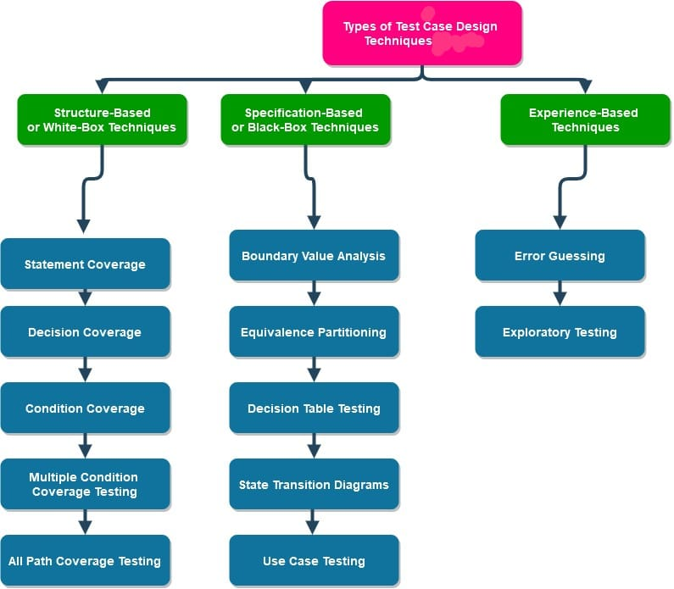
Test Case Design Techniques

Slide 6
Basic Example
Let us consider any e-commerce app or website (like Amazon or Flipkart) for test case design. We want to ensure users can quickly checkout and make payments without issues. Here we test for 1 product in the cart; we will see later that this test case design technique is a boundary value analysis technique.
Title: Test that user can complete the checkout process when there is 1 item in the card.
Description: Ensure users can checkout and make payments without issues on the website/app
Preconditions: The user is already logged in
Assumptions: They are using a supported device or browser to log in.
Expected Result: The checkout process should be complete, and the user should receive confirmation.

Slide 7
1. Manual Test Case Design
Manual test cases are step-by-step written test scenarios used by testers to validate software functionalities manually, without using automation tools.
📋 Structure of a Manual Test Case
Field | Description
Test Case ID | Unique identifier (e.g., TC_Login_01)
Title | A brief description (e.g., Login with valid data)
Precondition | Setup needed before test (e.g., User is registered)
Test Steps | Step-by-step actions the tester will perform
Test Data | Input values (e.g., username: admin)
Expected Result | What should happen if software works properly
Actual Result | What actually happens during testing
Status | Pass / Fail / Blocked

Slide 8
Benefits
Provides repeatable, documented tests
Easy for manual testers to follow
Acts as reference for regression testing

Slide 9
Example : Login Requirement
Field | Value
Test Case ID | TC_Login_01
Title | Login with valid credentials
Precondition | User has an active Instagram account
Test Steps | 1. Open app 2. Enter credentials 3. Tap login
Test Data | username: fahad123 password: xyz123
Expected Result | Home feed appears
Actual Result | (Filled after execution)
Status | Pass / Fail

Slide 10
Specification-Based or Black-Box Techniques
Specification-based testing is a technique to test software such as Web apps, Mobile applications, and Desktop applications.
It focuses on testing the features and functions of the software without needing to know the source code or structure.
These test case design techniques are also known as Black-Box techniques.
The Specification-Based testing technique is an input/output-based testing technique because it considers the software as a black box with inputs and outputs.
This technique is further classified into the following types:
BVA Boundary Value Analysis
Equivalence Partitioning (EP)
Decision Table Testing

Slide 11
2. Equivalence Portioning (EP)
A black-box test design technique where input data is divided into valid and invalid partitions (groups). A test case from each partition is enough to represent the entire class.
Steps to design Equivalent Partitioning test case:
Define the equivalence classes
Define the test cases for each class
Benefits
Reduces number of test cases needed
Ensures core behavior of system is tested
Efficient for large data input ranges

Slide 12
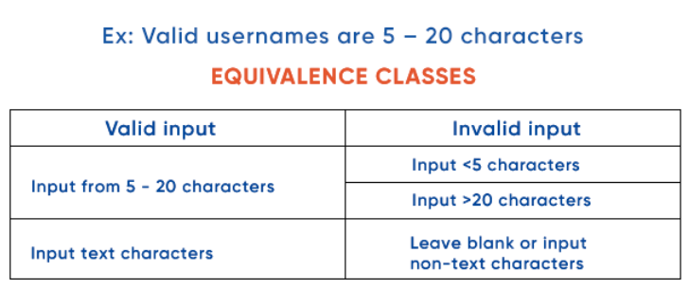
Example Valid Usernames
So, test cases will look like:
Case 1: Enter within 5 – 20 text characters: Pass
Case 2: Input <3 characters: Display error message “Username must be from 5 – 20 characters”
Case 3: Enter >20 characters: Display error message “Username must be from 5 – 20 characters”
Case 4: Leave blank or no-text characters: Display error message “Invalid username”

Slide 13
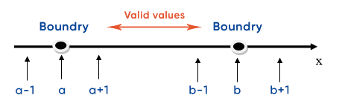
3. Boundary value Analysis (BVA)
Focuses on values at the edge (boundaries) of input ranges because bugs often occur at limits.
Finds off-by-one and limit-related bugs
Very useful in numeric input validation
Complements equivalence partitioning
Example: We would test with 0, 1, 2, 9, 10, and 11. We can expect that errors or defects are most likely to occur at or near the boundary values. Identifying these issues early can help prevent them from causing problems later in the software development process.

Slide 14
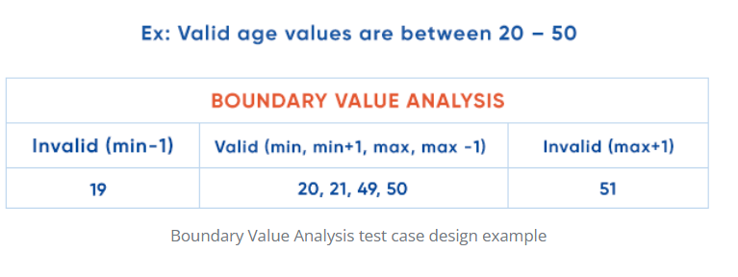
Example
Example: Valid age values are between 20 – 50.
Minimum boundary value is 20
Maximum boundary value is 50
Take: 19, 20, 21, 49, 50, 51
Valid inputs: 20, 21, 49, 50
Invalid inputs: 19, 51
Test cases will look like:
Case 1: Enter the value 19: Invalid
Case 2: Enter number 20: Valid
Case 3: Enter number 50: Valid
Case 4: Enter number 51: Invalid

Slide 15
Difference between EP & BVA
Yes, they do look similar because both deal with input ranges, but here’s the clear difference.
Feature | Equivalence Partitioning (EP) | Boundary Value Analysis (BVA)
🔍 Focus | Divides input into groups/partitions | Focuses on edge values (boundaries) of input
🎯 Purpose | To reduce test cases by covering one value per group | To catch boundary-related bugs (off-by-one errors etc.)
📥 Test Values | Any one value from each partition | Values on, just below, and just above boundary
✅ Example (Age 18–60) | Partitions: <18, 18–60, >60 → test with 15, 30, 65 | Boundaries: 17, 18, 60, 61
EP checks one value from each group (valid and invalid),BVA checks the limits of those groups.

Slide 16
4. Decision Table Testing
Technique used for functions that have complex logic or business rules. Inputs and conditions are represented in a table to show all possible combinations and their expected outcomes.
Conditions | Rule 1 | Rule 2 | Rule 3 | Rule 4
Logged In | No | Yes | Yes | Yes
Is Admin | No | No | Yes | No
Can Access Settings? | ❌ | ❌ | ✅ | ❌
Use cases like:
Pricing logic (discounts)
Eligibility (age + income)
Access control (roles)

Slide 17
Benefits
Helps cover all combinations
Prevents missed conditions
Best for testing decision-driven logic

Slide 18
Structure-Based or White Box Techniques
White Box Technique, also known as Structure-Based testing, is a testing technique that focuses on testing internal components or structures of software or applications. In this technique for testing, the tests interact with the code directly. The test cases are designed to confirm that the code works efficiently and correctly.
Some of the types are
Statement Coverage
Decision Coverage
Condition Coverage

Slide 19
Experience-Based Testing Techniques
Experience, skill, and instinct are the fundamentals for experience-based testing.
In this testing technique, testers or developers are left free to design various test cases in advance or create them on the spot during the test implementation; mostly experienced testers will do a bit of both.
Examples are
Error Guessing
Exploratory Testing

Slide 20
Much more
The discussed techniques were only the techniques but there are many like
Pairwise Testing: Combines inputs in pairs to minimize test cases while maintaining interaction coverage between variables.
Error Guessing: Relies on testers’ experience to identify potential error-prone areas in the application.
Statement Coverage: Ensures every line of code is executed at least once during testing.
Decision Coverage: Verifies all decision points in the code are tested for both true and false conditions.
Data Flow Testing: Analyzes variable definitions, usage, and flow to detect potential anomalies.

